Slide 1
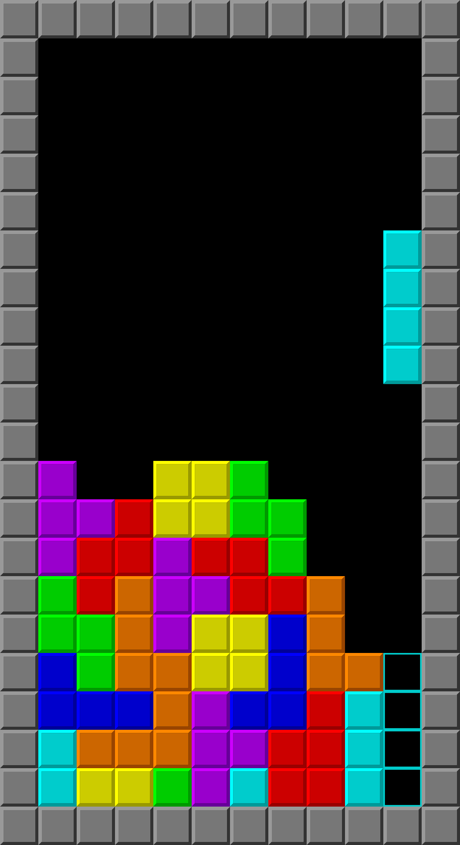
Developing Tetris in C++ Semester Project Presentation
Usman Awan (480836)
Photo by Pexels

Slide 2
01
Introduction to Tetris
Table of Contents
02
Libraries Used
03
Global Assets and Functions
04
Game Loop
05
Game Field and Graphics
06
Scoring
07
Conclusion
08
Credits

Slide 3
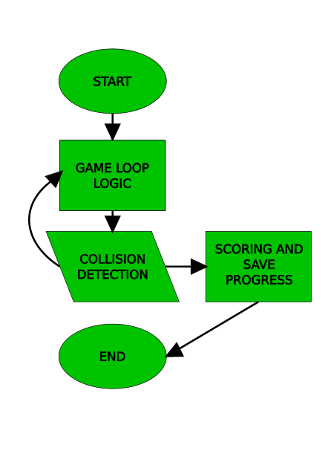
1
Introduction to Tetris
Tetris Origins
Tetris, created in 1985 by Alexey Pajitnov, involves arranging geometric shapes into lines. Flow Chart for the game’s mechanism is very simple
Game loop includes: Block fall, collision detection, input handling, and screen rendering.
Photo by Pexels

Slide 4
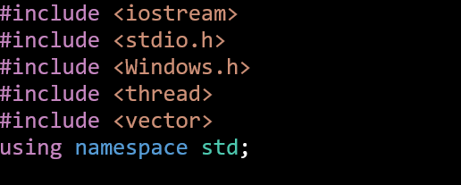
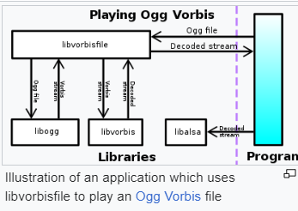
2
Libraries Used
C++ Libraries
Class libraries offer modular, reusable components of code for your projects. Using these allows for efficient and effective project development.
Key libraries used include iostream, stdio.h, Windows.h, thread, and vector.
Photo by Pexels

Slide 5
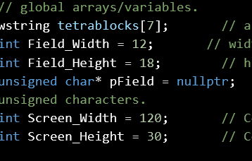
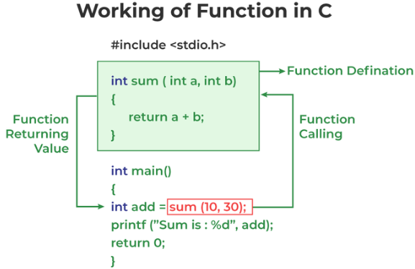
3
Global Assets and Functions
Essentials
Global assets are variables and arrays used across the project. Key variables include Field_Width, Field_Height, and Console screen dimensions. Important functions include Rotate_Block and Check_Block_Fitting.
Photo by Pexels

Slide 6
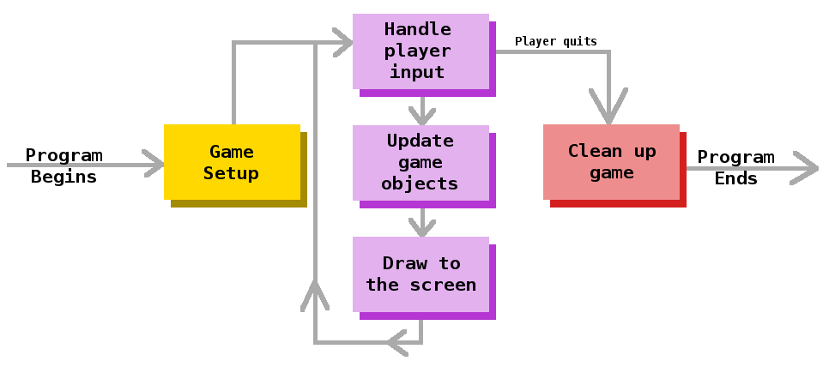
4
Game Loop
Core Logic
The game loop is the core logic controlling game flow and sequence. It manages game timing, input handling, and block falling. Collision detection is critical for block interactions within the game field.
Photo by Pexels

Slide 7
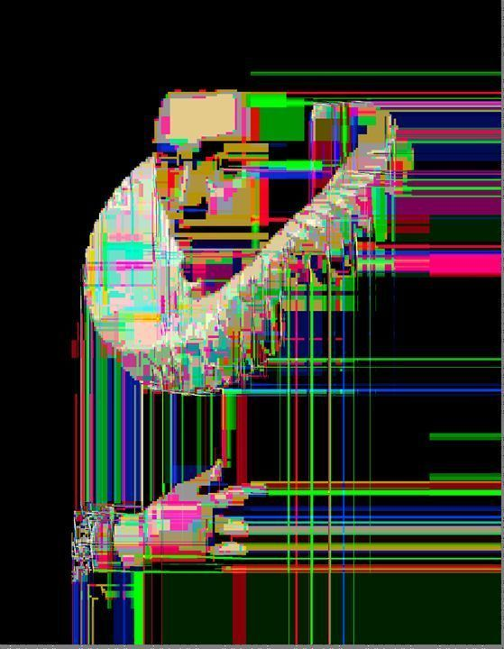
5
Game Field and Graphics
Visuals
The game field is the domain where gameplay occurs. <Windows.h> library is used for the graphics engine. The graphics engine emulates field on screen of dimensions 120 x 30.
Photo by Pexels

Slide 8
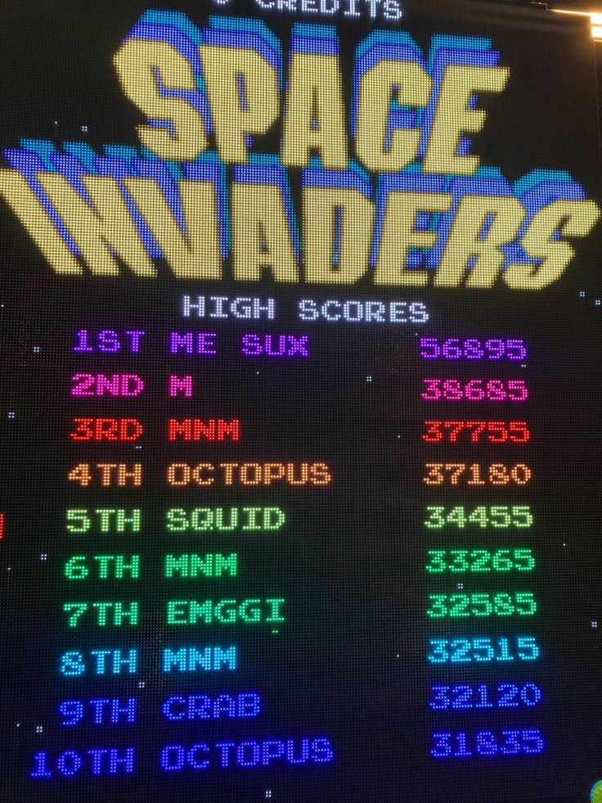
6
Scoring
Tracking Progress
Scoring mechanisms track player progress and provide feedback. It is integral in terms of the user experience File handling stores and retrieves scores securely. High scores motivate players to improve and compete.
Photo by Pexels

Slide 9
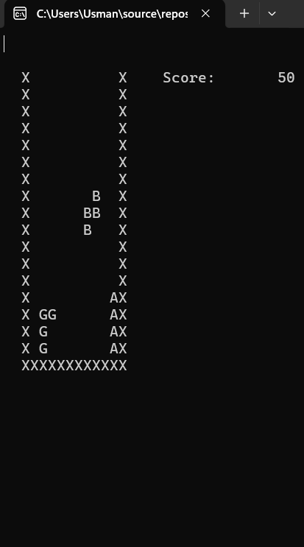
7
Conclusion
Summary
The project successfully replicates the NES version of Tetris. It integrates C++ libraries and global functions effectively. Assets and game loops are designed for optimal performance. Scoring and graphics enhance overall player engagement.
Photo by Pexels

Slide 10
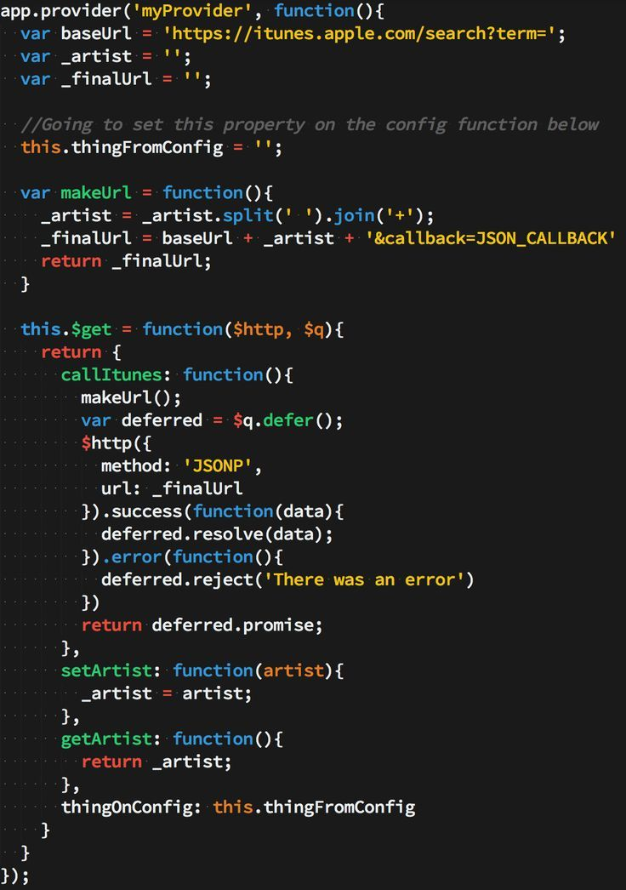
8
Hardware and Software
Technical Setup
The project was developed using PC hardware for testing and running the game. Key software includes C++, mingw compiler, and VS Code IDE. Hardware and software choices ensure compatibility and performance. Proper setup is crucial for successful project development and testing.
Photo by Pexels

Slide 11
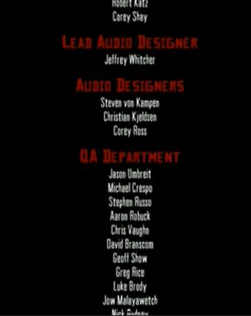
9
Credits
Acknowledgments
Acknowledgment of team members and their contributions. Special thanks to Professor Jahan Zeb and LE Sana Fatima. Gratitude for resources and guidance provided throughout the project.
Photo by Pexels

